Slide 1
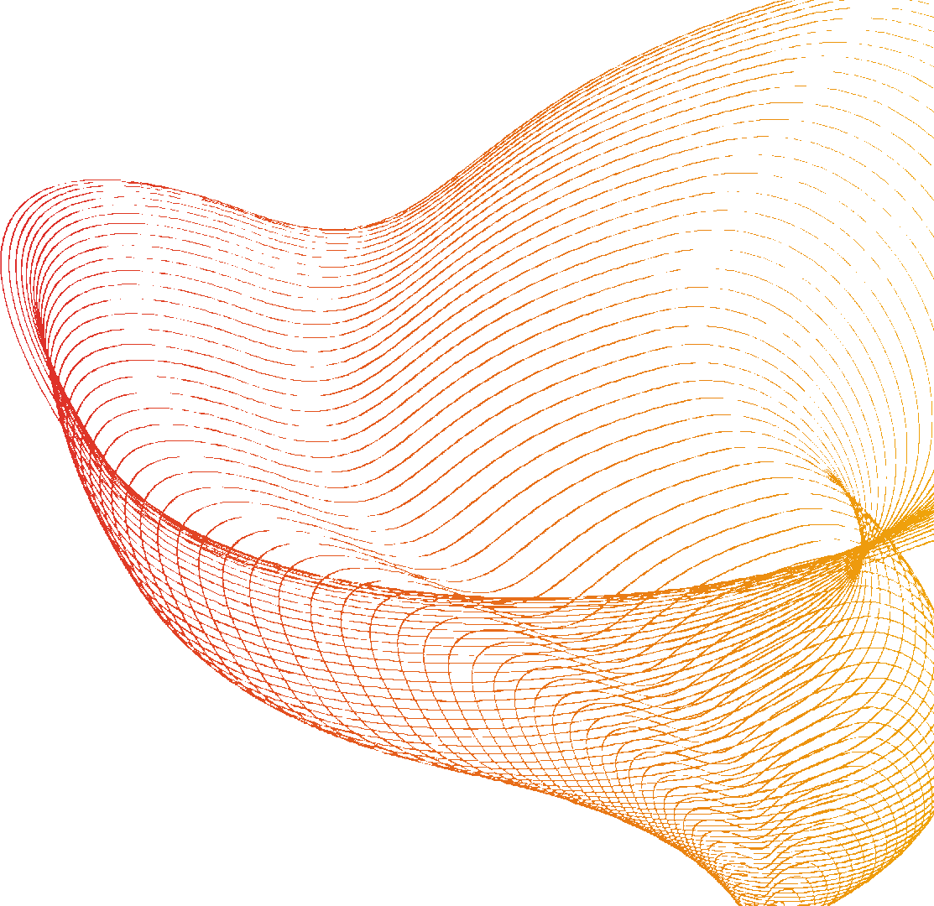


INF 423
Audio & Video stream analysis
Akhmatov Nurdaulet

Slide 2



Introduction
The analysis will cover both musical characteristics and public perception on these two platforms

Slide 3
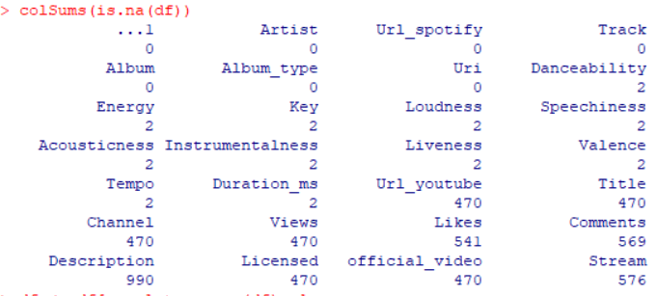
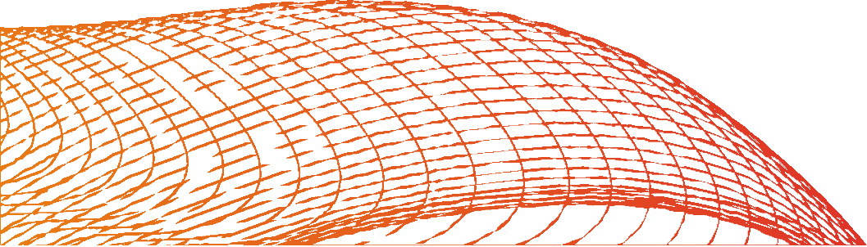
Data cleaning
Checking for missing values
First, we'll load the data and inspect it for missing values, outliers, and other anomalies.

Slide 4

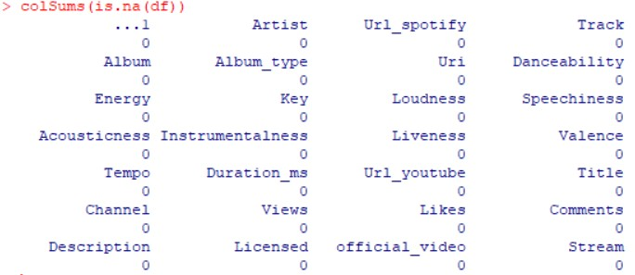

Data cleaning
If the missing data is not too high, we can remove the records with missing data

Slide 5

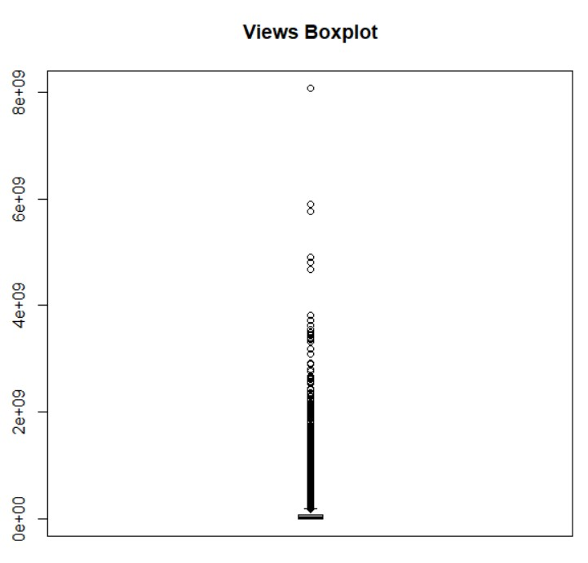
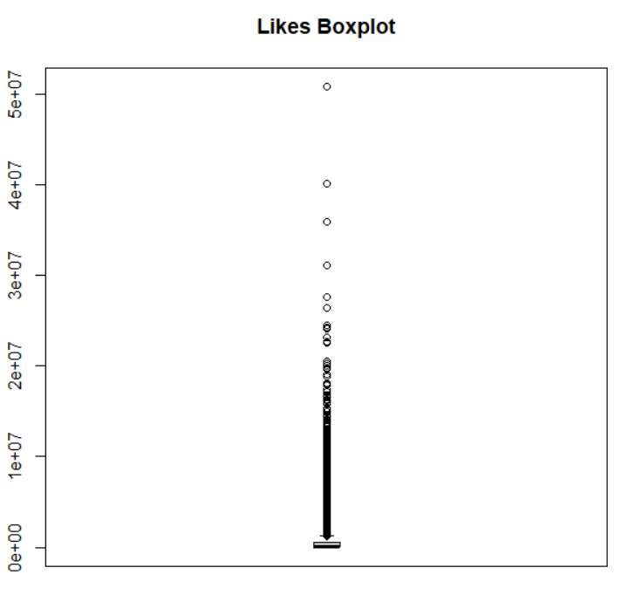

Data cleaning
Checking for outliers

Slide 6
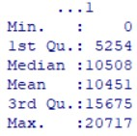
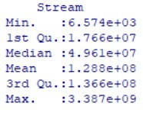
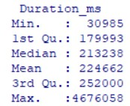
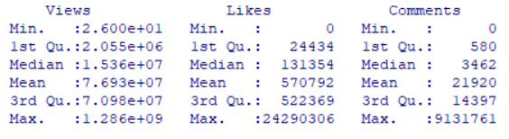

Descriptive Statistics

Slide 7

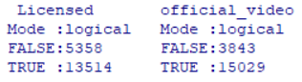
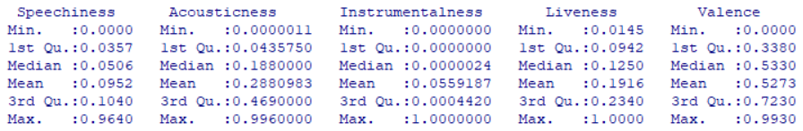

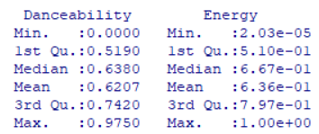
Descriptive Statistics

Slide 8

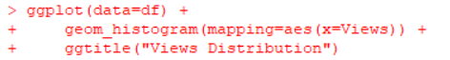
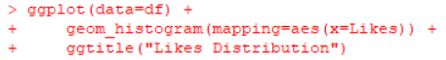
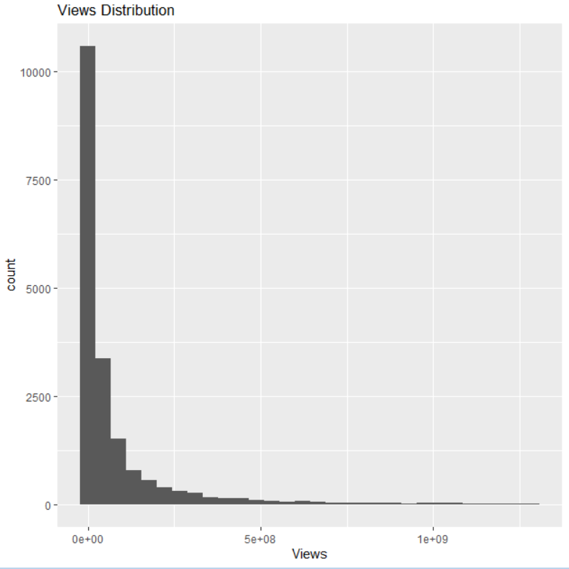
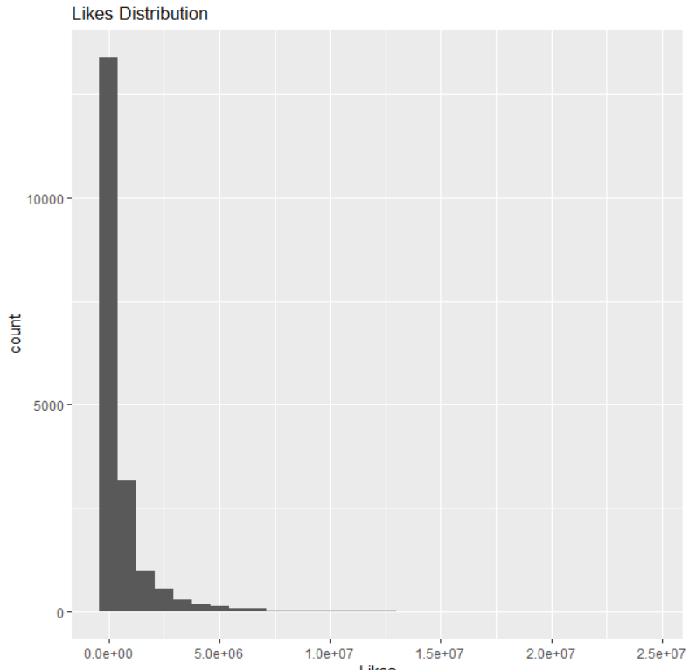

Descriptive Statistics

Slide 9
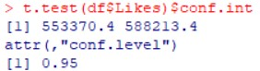
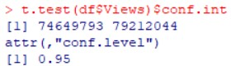
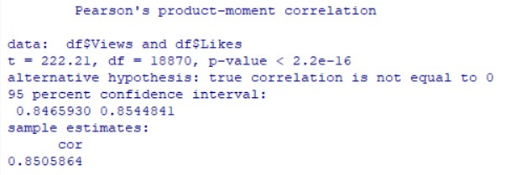

Inferential Statistics
Confidence interval for mean Likes
Confidence interval for mean Views
Testing the correlation between Views and Likes

Slide 10
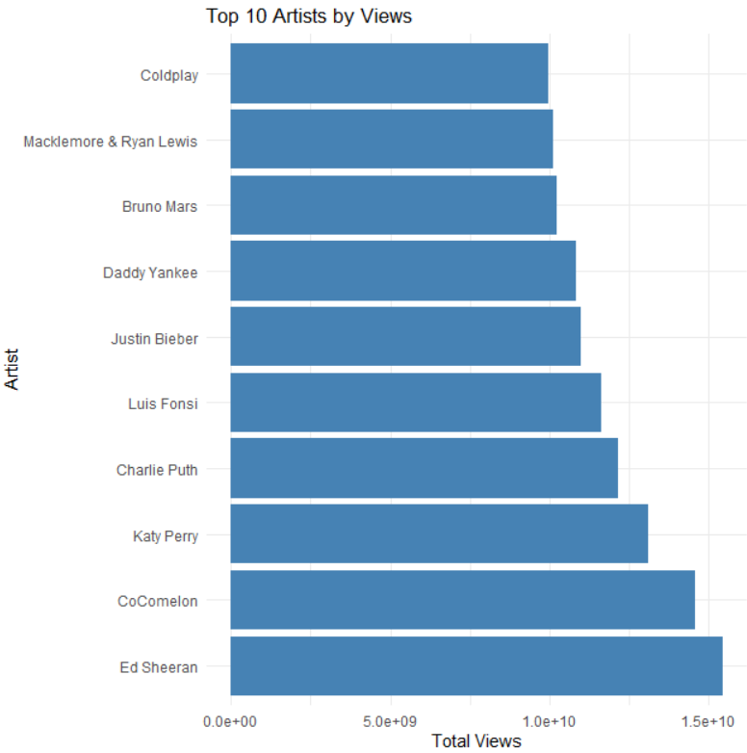
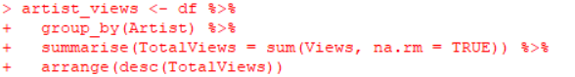
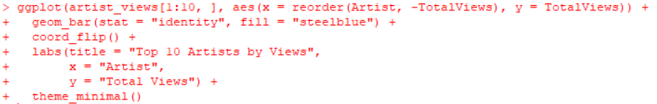

Group by Artist and calculate total views, then arrange in descending order
Create barplot of top 10 artists by views

Slide 11
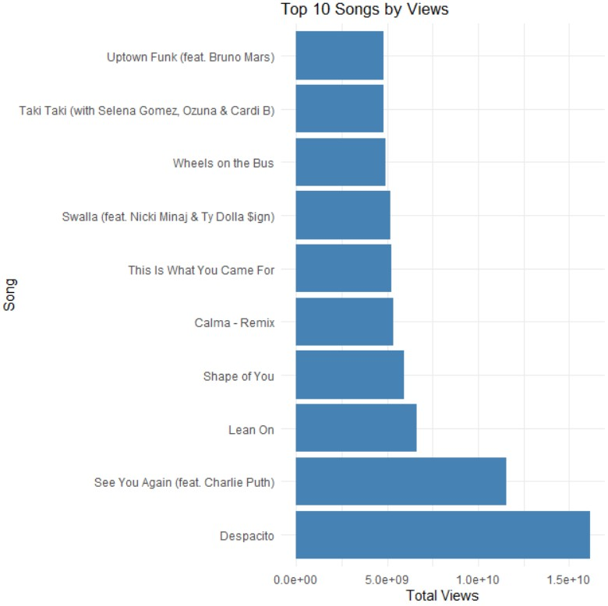
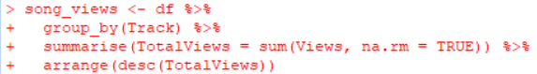
Group by Track and calculate total views, then arrange in descending order
Create barplot of top 10 songs by views

Slide 12
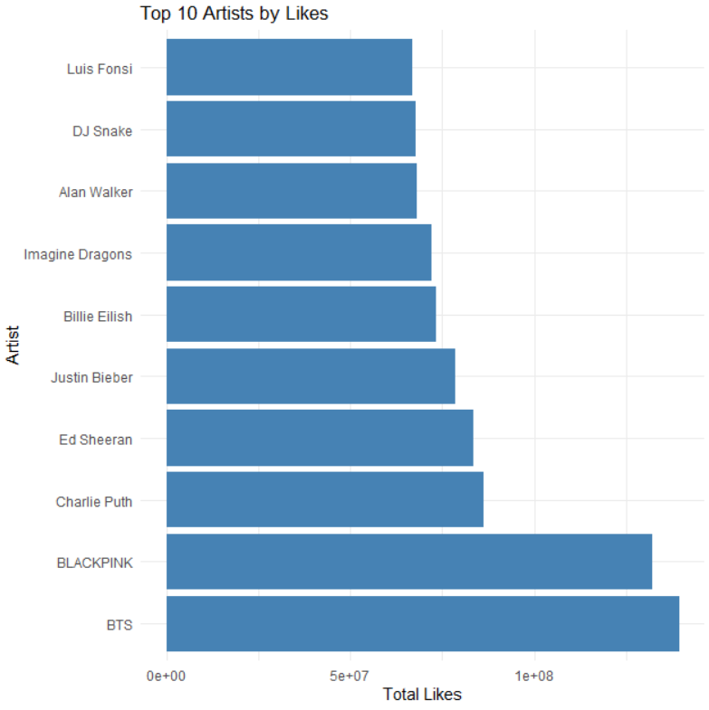
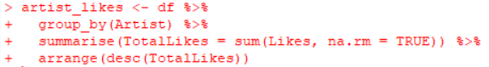
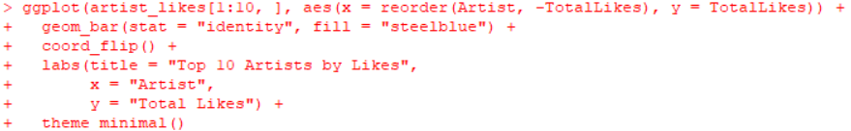
Group by Artist and calculate total likes, then arrange in descending order
Create barplot of top 10 artists by likes

Slide 13

Conslusion
Spotify and YouTube data reveals interesting patterns and relationships regarding the music preferences of listeners
'Danceability', 'Energy', 'Loudness', and 'Tempo' of a song are significant predictors of its views. The significance of these features varies, and this could guide artists and producers in focusing on these elements while creating their songs.
The bar plots of the top artists and songs by views and likes provide a clear visual representation of the data, further emphasizing the popularity of certain artists and songs over others.

